Slide 1

Optimizing Supply Chain Operation

Slide 2
Capstone Project II
Team Members
Vaibhav Arora
Nandeep Kaur
Semini Sehara Amarasinghe
Shivam Sharma

Slide 3
Overview
Dataset: DataCo Global Supply Chain
Data Source: dataset is available in website as mentioned below.
Mendeley repositorios: https://data.mendeley.com/datasets/8gx2fvg2k6/5
Kaggle: https://www.kaggle.com/datasets/shashwatwork/dataco-smart-supply-chain-for-big-data-analysis
Problem statement
In a competitive global market, businesses must enhance supply chain operations and inventory management to meet customer demands efficiently. The project addresses critical inefficiencies in the supply chain by analyzing factors that lead to customer churn, forecasting demand patterns, detecting fraudulent orders, and improving delivery reliability.

Slide 4

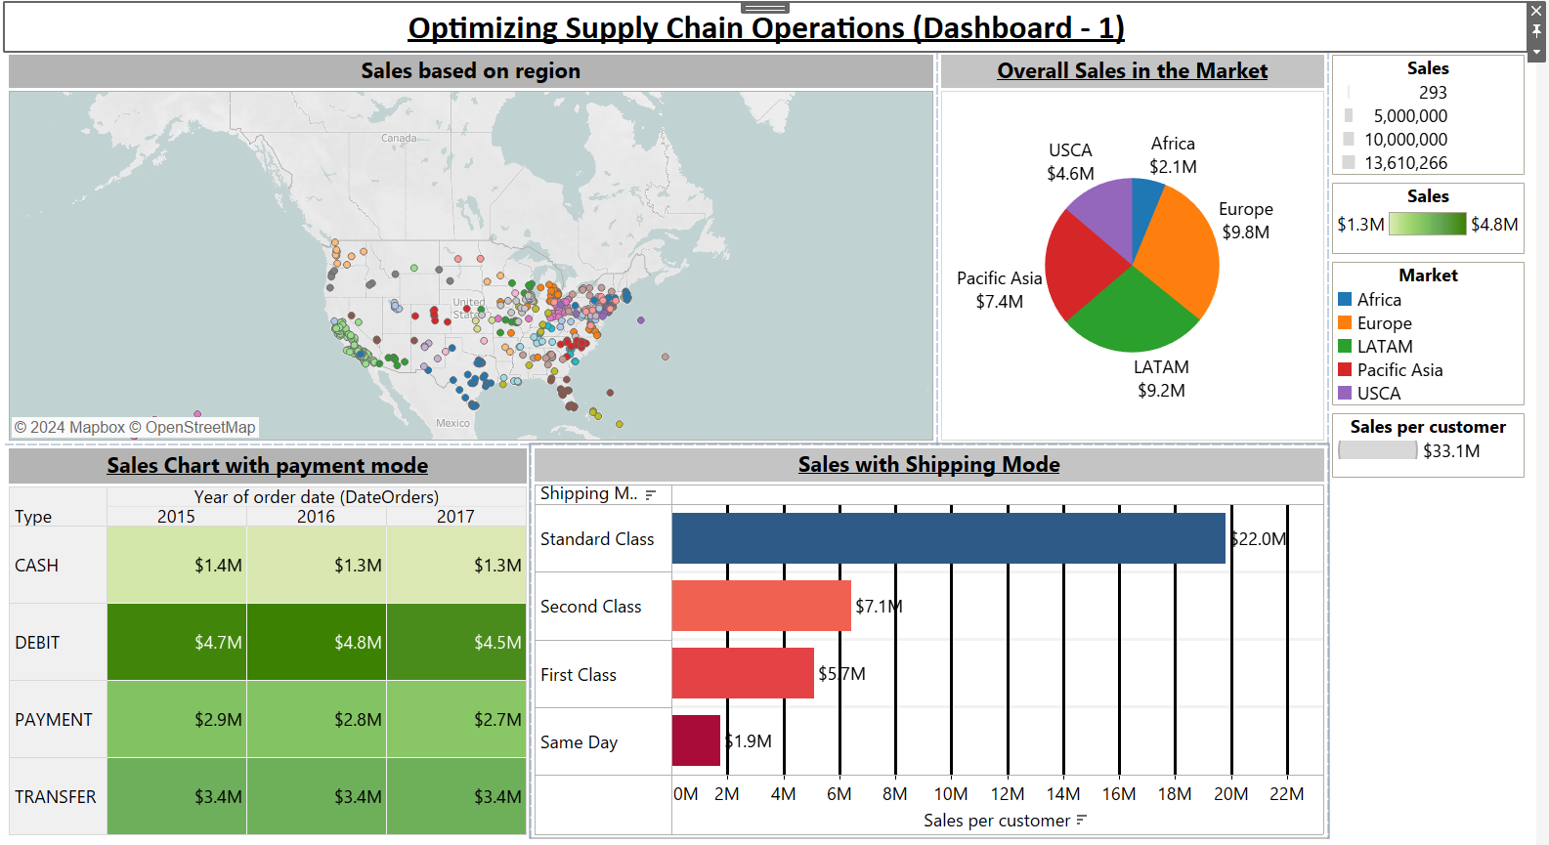

Slide 5
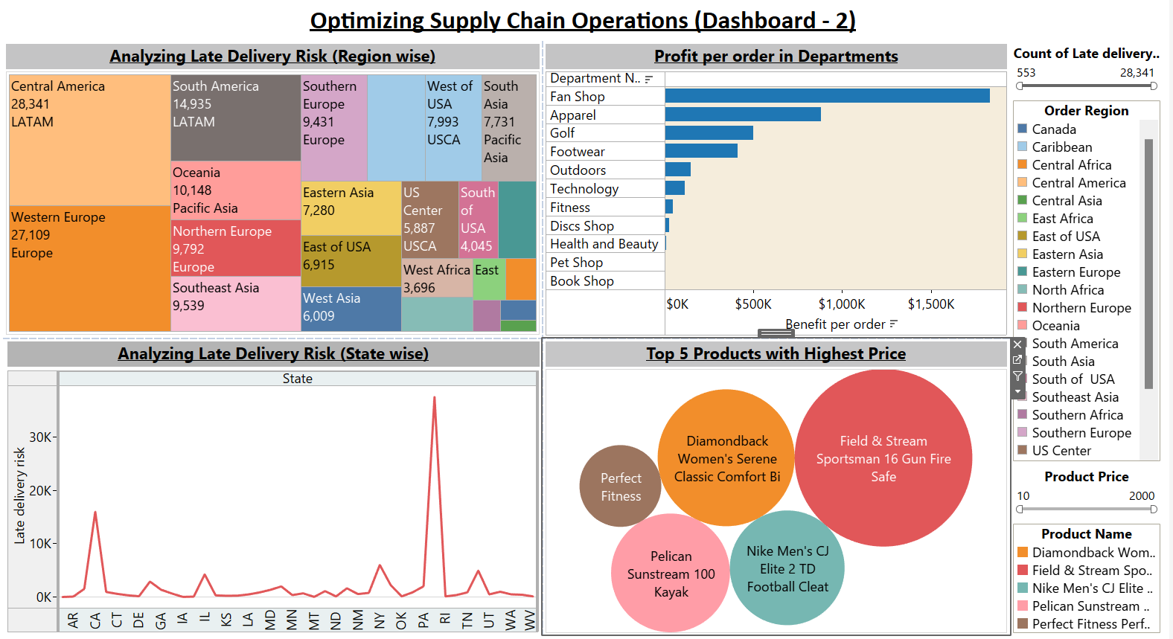

Slide 6
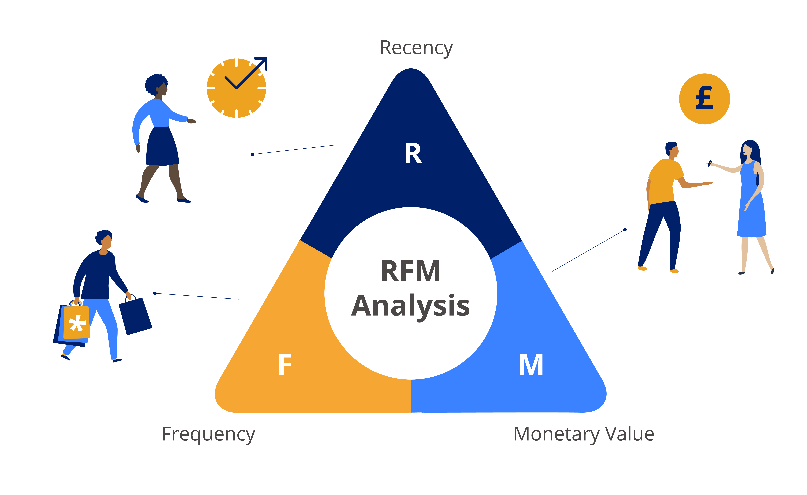
Phase – 1 Churn analysis with LTV
LTV(Lead Time Variance) refers to the difference between the expected (planned) lead time and the actual lead time for an order, process, or delivery.
Lead Time Variance = Actual delivery Time –Scheduled delivery Time.
Late Delivery Risk refers to the probability that an order will not be delivered by its scheduled or promised date.

Slide 7

Threshold point
RFM Score + Lead time variance
Business critic point
Churn threshold = 180 days lead time threshold = -2

Slide 8
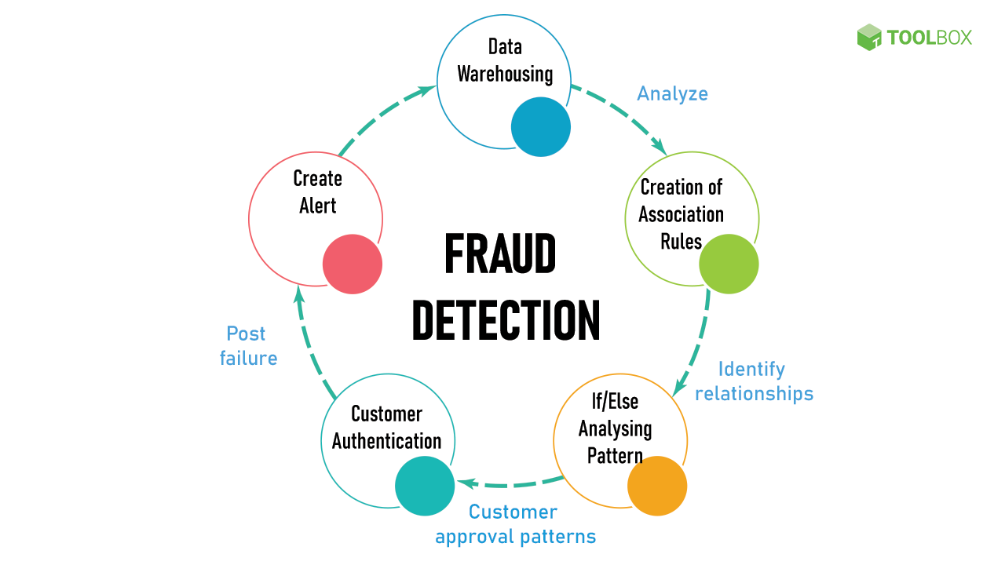
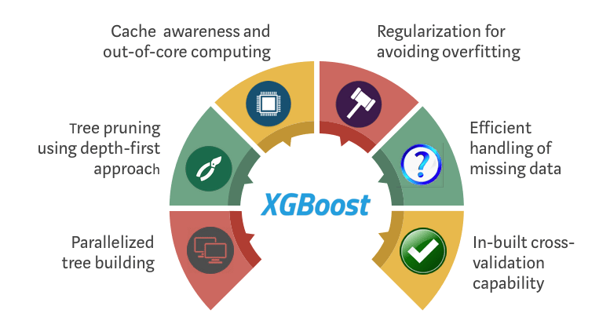
Phase 2 Fraud Order Detection
XGBoost (Extreme Gradient Boosting) is a super-fast and accurate machine learning model used for classification and prediction tasks.

Slide 9
Classification report
Class | Precision | Recall | F1-Score | Support
0 | 0.98 | 0.99 | 0.99 | 35,292
1 | 0.53 | 0.31 | 0.39 | 812
Accuracy |  |  | 0.98 | 36,104
Macro Avg | 0.76 | 0.65 | 0.69 | 36,104
Weighted Avg | 0.97 | 0.98 | 0.98 | 36,104
For fraud detection, recall is crucial — missing fraud means real financial loss. To fix this, we should apply techniques like SMOTE or cost-sensitive models to improve fraud detection performance.

Slide 10
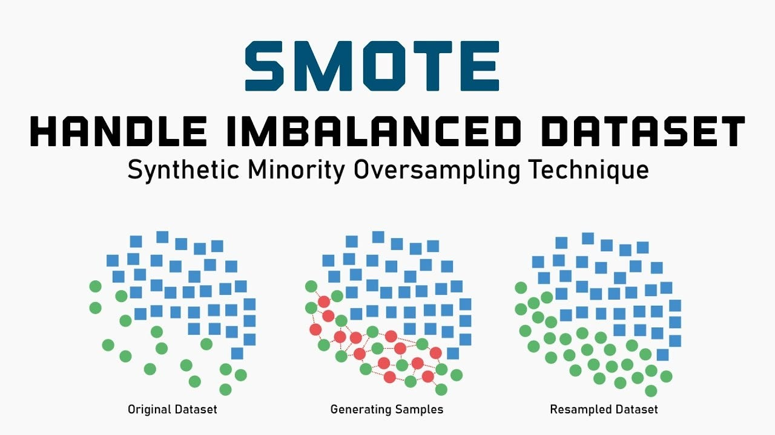
SMOTE balances the dataset by creating synthetic minority class samples. It helps the model learn rare cases better and avoids bias toward the majority class.

Slide 11
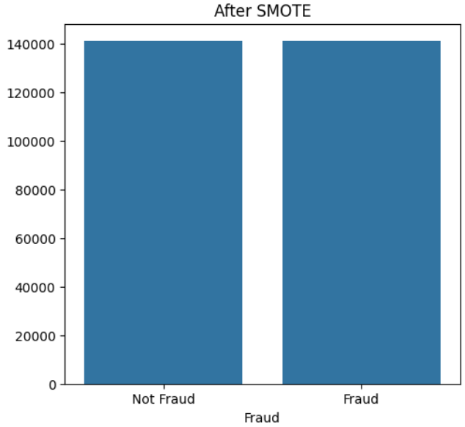
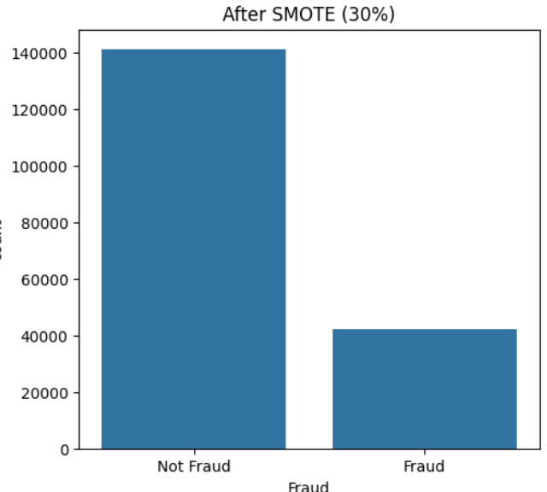
SMOTE (50-50)
SMOTE (30%)
Class | Precision | Recall | F1-Score | Support
0 | 0.99 | 0.98 | 0.99 | 35,292
1 | 0.41 | 0.52 | 0.46 | 812
Accuracy |  |  | 0.97 | 36,104
Macro Average | 0.7 | 0.75 | 0.72 | 36,104
Weighted Avg | 0.98 | 0.97 | 0.97 | 36,104
Class | Precision | Recall | F1-Score | Support
Class 0 | 0.99 | 0.99 | 0.99 | 35,292
Class 1 | 0.51 | 0.49 | 0.5 | 812
Accuracy |  |  | 0.98 | 36,104
Macro Average | 0.75 | 0.74 | 0.74 | 36,104
Weighted Avg | 0.98 | 0.98 | 0.98 | 36,104

Slide 12
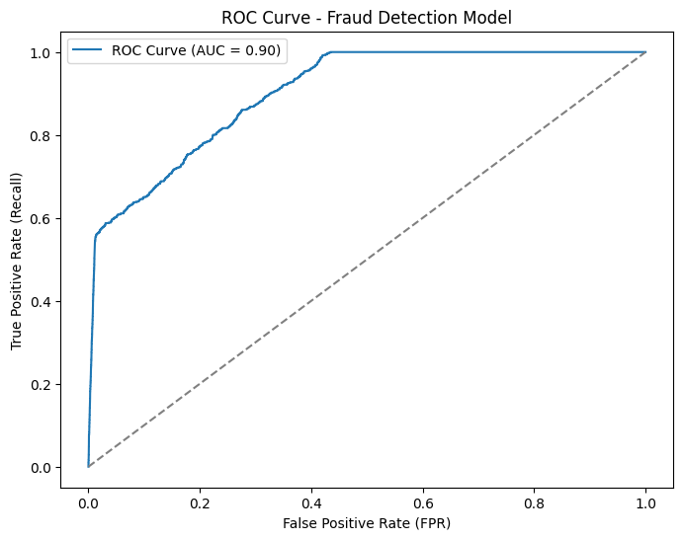
ROC Curve (Receiver Operating Characteristic Curve)
The ROC curve shows how well your model separates fraud from non-fraud cases.
True Positive Rate (TPR) → Recall (How many frauds were correctly identified?)
False Positive Rate (FPR) → How many normal orders were wrongly flagged as fraud?
AUC (Area Under the Curve)=1.0 (100%) → Perfect model (best case scenario).AUC = 0.5 (50%) → Random guessing (worst case scenario).
our AUC = 0.90 → our model is 90% good at distinguishing fraud from non-fraud.

Slide 13
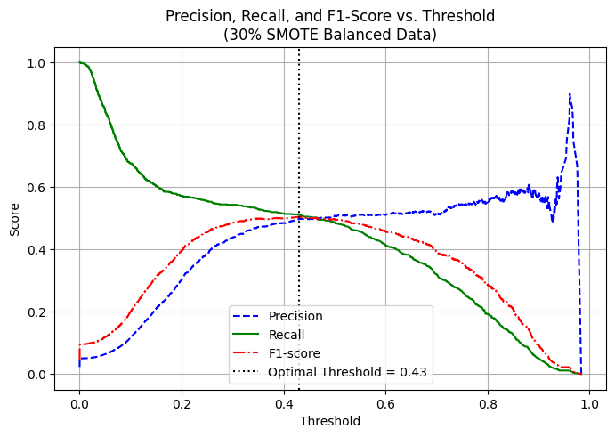
Optimizing Threshold for Best Model Performance
The optimal threshold is 0.43, where the F1-score peaks — this is the best balance between precision and recall.
It helps maximize overall fraud detection performance on SMOTE-balanced data.

Slide 14
Adjusting the Threshold Point
Note:
Point of threshold based on the business needs and they cannot adjust or change precision and recall at once.
0.2
Maximize the fraud detection
0.43 Threshold point
0.6
Minimize the false alarm

Slide 15

Phase 3 Shipment Optimization

Slide 16
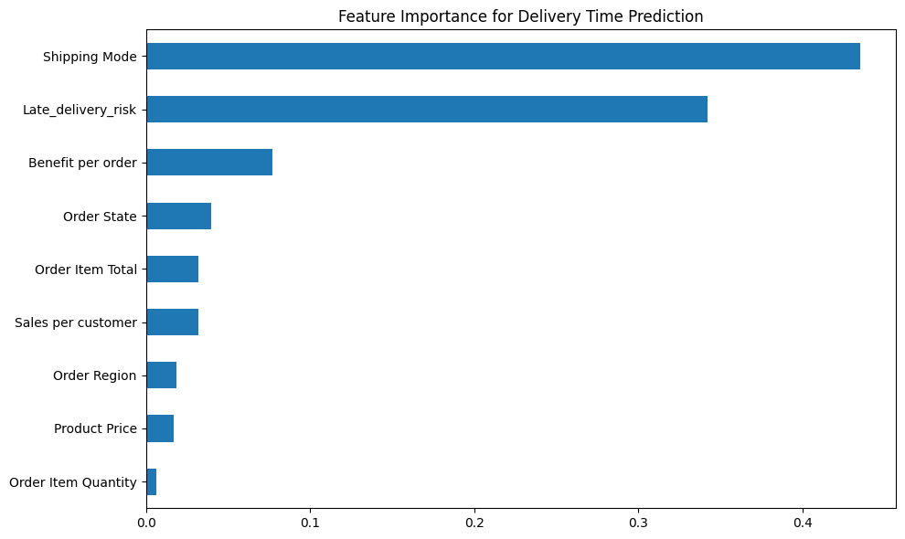
Feature Importance
The model shows that Shipping Mode and Late Delivery Risk are the two most critical factors affecting delivery time. Other features like benefit, region, and price have much smaller impact

Slide 17
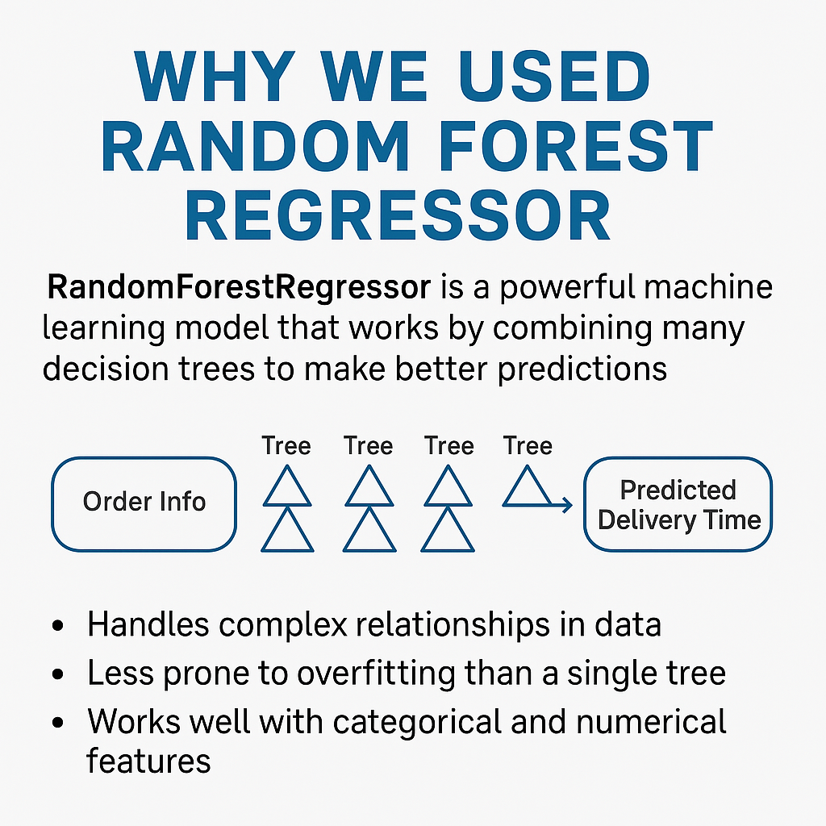
Each tree makes a guess on delivery time based on order info (like region, quantity, or risk).
The Random Forest takes all those guesses and averages them, giving us a more accurate prediction.

Slide 18
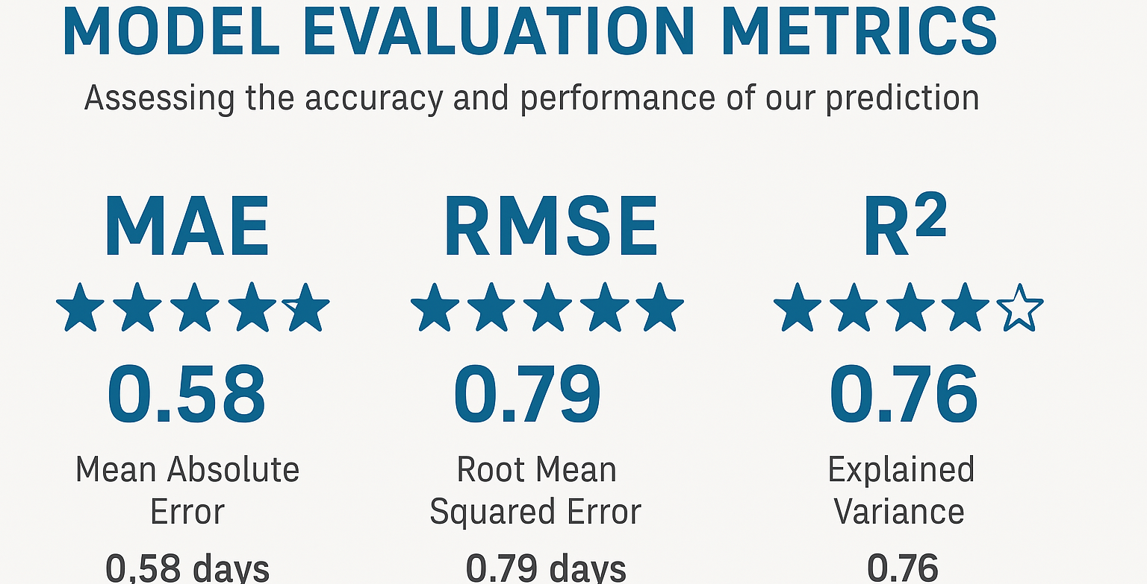
if it predicts 5 days, it might be actual 4.5 or 5.5 — that’s very close.
RMSE also shows error, but it gives more weight to big mistakes.
Measures how well the model fits the real data.

Slide 19
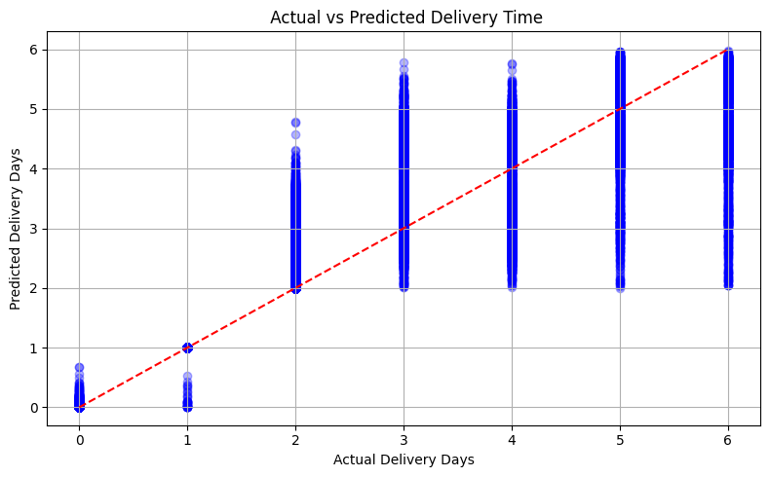
Actual vs Predicted Delivery Time
This chart shows how close our model’s predictions are to the actual delivery times.
Each blue dot represents one order.
The red diagonal line indicates perfect prediction (Predicted = Actual).
Most dots are clustered around this line, especially between 2–5 days.This means the model is predicting delivery time very accurately for most cases.

Slide 20
Business Critic Points
Data-driven automation across churn prevention, fraud detection, and delivery optimization leads to higher customer satisfaction, reduced costs, and improved supply chain agility.
Strategy Focused | Model Used | critic point | Business Action | Recommendation
Customer Retention | Logistic Regression Churn Prediction using LTV + RFM | Delivery Delay >180 days + delay (-2 days) | Prioritize fast delivery for high-value customers | Launch targeted retention campaigns for at-risk segments.
Fraud Detection | XGBoost Classifier SMOTE ROC AUC | ROC AUC = 90%, Optimal Threshold = 0.4 | Integrate model into real-time order screening | Flag and review orders near threshold to minimize financial loss.
Delivery Optimization | Random Forest Regressor | 0.58 days | Predict delivery time based on Shipping Mode, Region, and Order details. | Display accurate ETAs to customers and adjust route planning based on prediction.

Slide 21
References
A Case Study in Credit Fraud Detection With SMOTE and XGBoost
https://www.researchgate.net/publication/343720451_A_Case_Study_in_Credit_Fraud_Detection_With_SMOTE_and_XGBoost

Slide 22
Special thanks to our professor, A. Sodiq Shofoluwe, for guiding us in linking critical business insights across each phase of the shipment optimization project.
Thank you

